Slide 1

UnAcademy
To provide digital education for all types of learners.
Team: Cyclone
Hareesh Dasari
Imran
Hari Priya
Rukma
Akhila

Slide 2
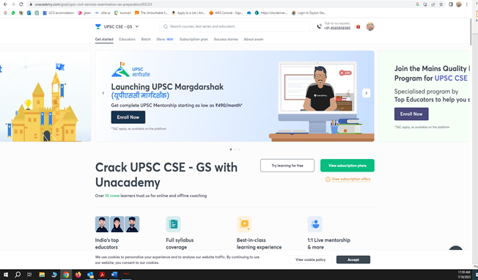
Product description: (Hareesh)
Unacademy is an innovative and comprehensive educational platform. Aims to revolutionize the way people learn and acquire knowledge. Provides high-quality education to learners of all ages and backgrounds.
Vast library of video lectures, live classes, and interactive quizzes. Courses covering diverse subjects: academics, competitive exams, language learning, coding, business, arts, and personal development.
Learners can ask questions and participate in discussions. Personalized feedback from expert educators for active learning and knowledge retention.
Flexible Learning Approach where 24/7 access to educational content to learn at your own pace and convenience. Study anytime, anywhere, with multiple device accessibility (smartphones, tablets, and computers).
Dedicated to democratizing education and making it accessible to all.
Choose between free and subscription plans to suit your needs and budget.
Subscription plan offers additional benefits like ad-free viewing, live doubt-solving sessions, and personalized learning paths.

Slide 3
Scope Statement: (Hareesh)
Unacademy is designed as an accessibility tool to complement the formal education system, not to replace it.
The project aims to reform the current learning method, making education affordable and accessible to all, regardless of social, economic, cultural, or geographical boundaries.
The success of Unacademy requires a diverse team, including:
Developers: Responsible for designing and building the platform.
UX/UI Designers: Ensuring a user-friendly and visually appealing interface.
Stakeholders: Providing guidance and support throughout the project.
Managers: Overseeing project progress and coordination.
IT Support: Ensuring smooth functioning and technical assistance.
Before deployment, major participants like:
Testers: Ensuring the platform's functionality and performance.
Other Team Members: Contributing expertise in their respective domains.
Unacademy allows live telecasting of lectures or course content on major platforms like: YouTube, Instagram, Twitch
Specific functionalities will be integrated into the algorithm to facilitate seamless live streaming.
Unacademy module development will adhere to the following standards:
PCI-DSS: Ensuring secure payment processing.
Data Privacy & Security Laws: Compliance with region-specific regulations to safeguard user information.
Unacademy aims to empower education and create opportunities for learners worldwide.
By providing a user-friendly platform and live telecast features, it enhances accessibility.
Compliance with security standards ensures a safe and trustworthy learning environment.

Slide 4
Schedule Management: (Hareesh)
S.no | Milestones (Workflow) | Approximate Duration
1 | Plan & Approach | 1-2 Weeks
2 | Design | 3-5 Weeks
3 | Writing and assembling content | 6-7 Weeks
4 | Development and Programming | 7-12 Weeks
5 | Testing and review | 13-17 Weeks
6 | Website launch | 18-19 Weeks
7 | Maintenance and enhancements | 19-20 Weeks

Slide 5
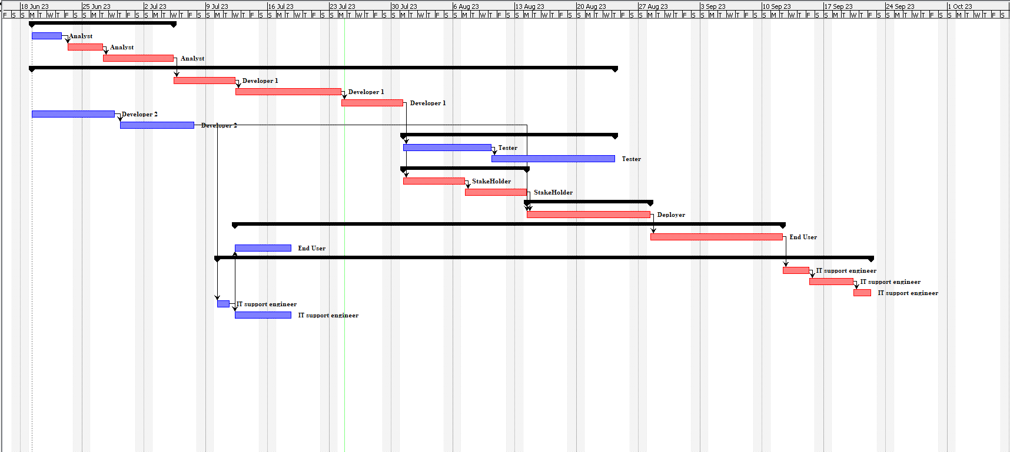
Gantt Chart: (Hareesh)

Slide 6
Project cost management (Imran)
Cost management is a vital process that involves organizing and supervising a project's budget. It plays a crucial role in helping project managers estimate costs accurately and implement controls to minimize the risk of exceeding the budget.
As projects typically require resources like manpower, supplies, and equipment, cost management becomes essential to ensure efficient allocation and utilization of these assets while keeping expenses in check.
Effective cost management is crucial throughout the project's lifespan to predict, monitor, and manage expenses to successfully complete the project within budget constraints.

Slide 7
Key Benefits of cost management.
Cost management offers several key benefits, including:
- Avoiding cost overruns: By carefully analyzing and controlling expenses from the outset, project managers can prevent overspending in specific areas.
- Risk mitigation: Establishing a well-defined budget helps businesses maintain project momentum, even when unexpected expenses arise, reducing the impact of financial risks.
Future planning support: Effective organization of resources enables the creation of accurate budgets for future projects, aiding in better planning and allocation of resources.

Slide 8
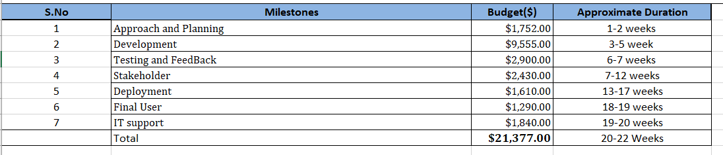
Stages of cost management.
Resource planning, Cost estimate, Cost budgeting, and Cost control are the four stages of cost management, which can be broken down into a continuous process if necessary.
Resource planning is the process of identifying and allocating the necessary resources required to execute and complete a project.
Cost estimation involves determining the anticipated expenses associated with acquiring all the necessary materials to complete a project.
Cost Budgeting: Cost budgeting is a distinct process that involves allocating expenses to specific portions of a project, such as activities or units, for a predetermined period.

Slide 9
Project quality management (Imran)
Project quality management for Unacademy ensures that high standards are maintained throughout the development process.
It includes activities such as defining quality metrics, conducting regular inspections, implementing quality control measures, ensuring adherence to standards, and continuously improving the platform to deliver an exceptional learning experience.
These three procedures make up project quality management:
Quality planning: involves identifying potential risks, setting high standards, organizing processes, and defining testing procedures to ensure performance achievement, control, anticipation, and verification.
Quality assurance: Quality assurance in the creation of the Unacademy project involves systematic processes and activities to ensure that the developed platform meets the defined quality standards.
Quality control: Quality control refers to the operational techniques employed to ensure adherence to quality standards.

Slide 10

Risk Management (Hari Priya)
Risk Management Plan: Risk management is the practice of identifying, evaluating, and mitigating or reducing potential risks that could impact a project's desired outcomes. Project managers are responsible for overseeing the risk management process throughout the entire project duration.
Project managers must be mindful of the various risks they may encounter, which can vary depending on the project type.
Monitor and control Risk: The process of monitoring and controlling risks involves executing response plans, continuously tracking identified risks, identifying and addressing new risks as they arise, and enhancing risk management procedures. It also includes evaluating the effectiveness of implemented risk response plans, identifying potential risk factors within the project, assessing the need for modifications or closure of existing risks, and maintaining vigilance over ongoing risks.

Slide 11
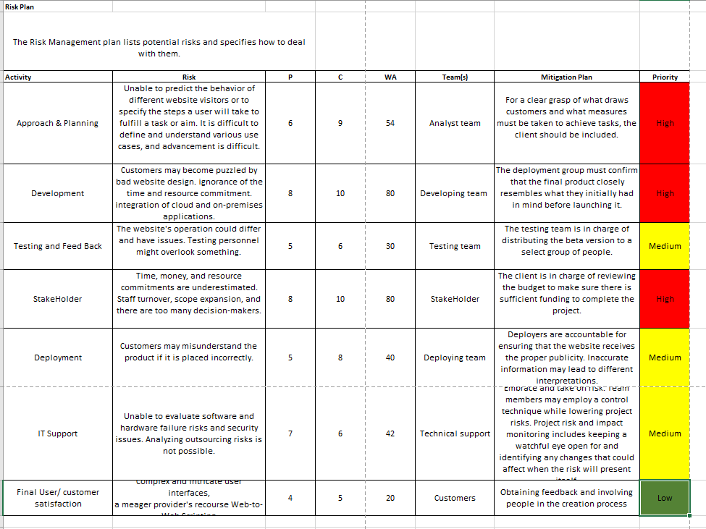

Slide 12
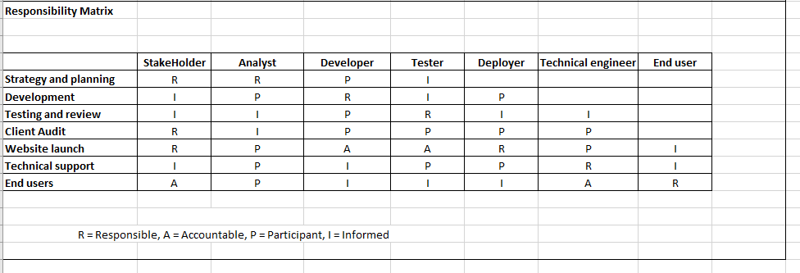
Resource Management Plan:
Resource Project Management: The resource management plan is critical for project success as it involves planning, organizing, managing, and evaluating the efforts of project resources. Its goal is to effectively allocate, schedule, and utilize resources within the organization. The project manager must ensure adequate resources are allocated to specific process procedures. This involves following procedural stages, such as creating a comprehensive plan that considers the required number of employees and their availability for project delivery, monitoring resource utilization, and conducting regular team meetings to track progress and recognize achievements.

Slide 13
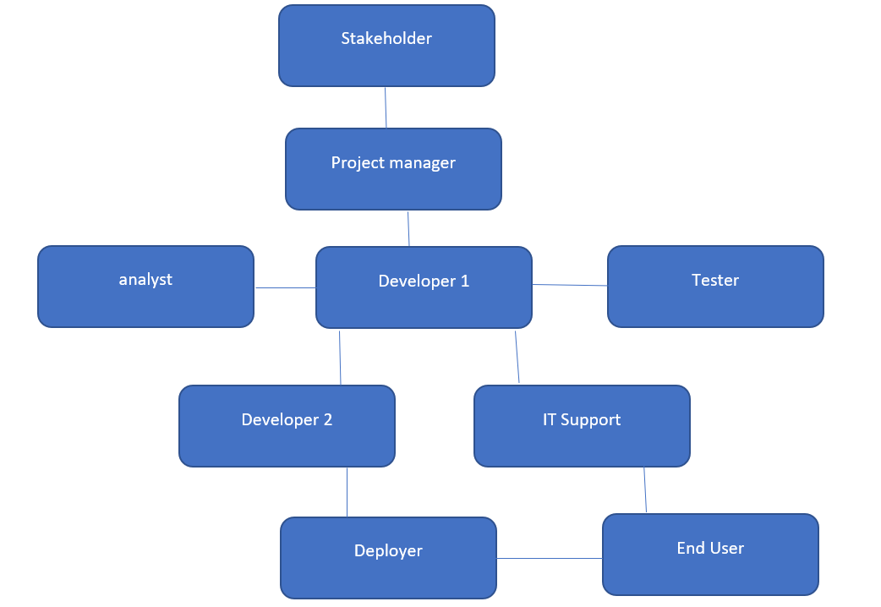
Resource Management (Continued)
Organizational Structure: An organizational structure serves as a blueprint or framework for effectively carrying out tasks. It establishes procedures that act as a roadmap for achieving business success. By depicting the distribution of power and information within the company, it facilitates clarity regarding roles, responsibilities, and accountability for everyone involved.
Resource Estimation & Acquisition: Resource estimation involves allocating the required resources to specific project activities, encompassing not just the necessary skill sets but also hardware equipment and software needed for project completion.
Resource Team Management: The management team actively engages in weekly reviews and team performance evaluations, providing necessary training to enhance skill sets as needed. Issues are addressed promptly, ensuring projects are completed on schedule and within budget.

Slide 14
Communication Management Plan
(RUKMA)
Communication management is foundational for any project, and a well-established communication plan is crucial for effective project implementation.
Regular team sessions promote better understanding of project progress and encourage the exchange of diverse perspectives.
Weekly reports and idea sharing enhance clarity on project progress and facilitate the tracking of development.
The Unacademy team's communication plan focuses on establishing effective communication channels with all members, ensuring regular updates on minor developments and progress.

Slide 15

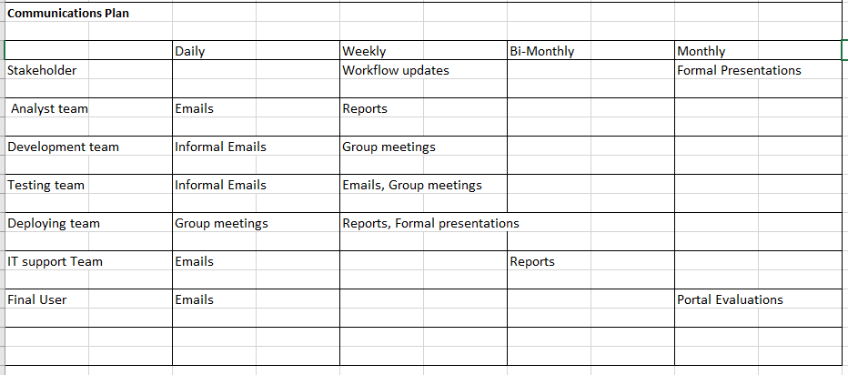

Slide 16
INTEGRATION MANAGEMENT
(RUKMA)
Integration Management involves coordinating and controlling project processes and elements for successful execution.
Key Phases :
Project Charter
Project Management Plan
Directing and Managing Project Work
Monitoring and Controlling
Integrated Change Control
Project Closure
By implementing Integration Management, Unacademy ensures harmonious collaboration among project elements, leading to a successful and affordable educational platform meeting student and educator needs

Slide 17
Stakeholder Management
(AKHILA)
Project managers, who are responsible for a variety of project-related activities, have a crucial duty to fulfil. Stakeholders have a big say in how the project turns out. Stakeholder management is effective and is essential for ensuring that project managers' initiatives live up to stakeholders' expectations.
Identify stakeholders:- This includes a list of all parties involved in the project, including clients, investors, and other important parties. The project manager takes lead in directing this procedure and compiling information on each stakeholder's influence, function, and areas of interest into a stakeholder registry.
Plan stakeholder engagement:- For a project to succeed, it is essential to develop ways for involving stakeholders. All project participants will receive a clear and useful plan from this stage of project management, which will ultimately benefit the project as a whole.
Manage stakeholder engagement. Stakeholder management's main goal is to manage stakeholder communications in a way that meets their expectations and quickly resolves any problems that may arise.
Monitor stakeholder engagement:- It comprises ongoing stakeholder relationship monitoring and strategy adjustment as the project develops. The project's activities are kept effective and efficient thanks to this procedure. It entails gathering information, evaluating the degree of stakeholder involvement, and coming up with fresh ways to actively include stakeholders.

Slide 18
Name | Role | How much does this project impact them? | Project Rank Interest Influence 1-5 | What we would like them to do? | When are they needed? | Strategy for Engaging and Managing
The customer or the client party. | Arranges the finances for the website's development. | Primary shareholder. | 2 Interest 4 Influence | Offer feedback consistently during the process. | From start to completion of the project. | Arranging client meetings involving important representatives.
Programmers or software engineers involved in website development, specifically focusing on either the frontend or backend aspects. | Typically, the individuals most crucial to website development are those involved in programming. | They serve as the vital core of the project, as without their work in website development, there would be no user interface. | 5 Interest 3 Influence | Front-end developers are responsible for constructing the visible elements of a webpage, including its layout, style, and overall aesthetic appeal, ensuring a user-friendly experience. On the other hand, backend developers handle the creation and execution of the behind-the-scenes components of the website that are not publicly visible. This includes managing the database, which stores website content, and implementing the web server application on the backend. | They play a crucial role throughout the entire process. | Customer expectations will be established through frequent discussions and meetings with clients.
Writers responsible for creating content. | writers are vital stakeholders in a website project as they are responsible for creating the informational content on the website, including details about the business and its offerings. It is crucial to keep them well-informed about all the essential project specifics. | In order to meet their deadlines, all writers involved in website development must have access to current schedule information that informs them about their respective deliverable dates. | 3 Interest 3 Influence | They schedule meetings with the client to gather information about the company's mission, philosophy, values, preferred language, and tone for the content. Based on this input, the writers will create an initial draft, which will be reviewed by the client. The writers will then incorporate the feedback and make necessary updates to deliver the final product. | Freelancers are commonly engaged as writers, often at the beginning of the project. | Regular client meetings are held.

Slide 19
Name | Role | How much does this project impact them? | Project Rank Interest Influence 1-5 | What we would like them to do? | When are they needed? | Strategy for Engaging and Managing
The team responsible for managing information technology. | The IT infrastructure team, although less apparent, plays a crucial role as stakeholders in a website project. Without their presence, the website would not come into existence. | The team is responsible for performing the comprehensive technical setup, which involves configuring storage and RAM, crucial for ensuring optimal performance of the website. | 3 Interest 4 Influence | The infrastructure team supplies internet servers, web servers, storage, network equipment, and operating systems, along with the physical hardware and communication mediums necessary to connect computers and users on the website. | Their presence will be required until the completion of the project. | Regularly engaging with all project teams and inquiring about their infrastructure needs.
The team assigned to conduct testing. | Prior to launching the website, it undergoes testing to identify and resolve any potential issues or bugs. | Testing is an essential phase in any project to identify and address faults and bugs. | 4 Interest 3 Influence | Identify and report bugs and issues to the software development team. | The testing team is needed promptly after the development team finishes a feature or project. | Incorporating them into daily meetings to stay updated on the progress of the development team.
The team responsible for deploying or launching the project. | The deployment team is responsible for launching the website and making it publicly accessible. | Ensuring the website is live is of utmost importance. | 4 Interest 3 Influence | Once the testing is finished, the deployment team is responsible for ensuring that the project is prepared for online launch. | The deployment team carries out the final phase once all preceding processes have been concluded. | Motivate their participation in the weekly and customer meetings, as it provides customers with a comprehensive overview of the product.
The individuals who will ultimately utilize the website, including both end users and employees. | They will utilize the forthcoming website. | By collaborating with employees or end-users, you can collect feedback on the usability and design of the website. | 5 Interest 1 Influence | Prior to the website's release, it is essential to identify any technical or usability challenges. | Towards the conclusion of the project. | Detecting any issues or flaws on the website and communicating them to the testing and development team through email correspondence and meetings.

Slide 20
Project Procurement Management
(AKHILA)
Plan Procurement Management: a. The project is currently in the planning stage. A statement of work is necessary for every contract involving outside help. This provides as official proof of the performed task, guaranteeing transparency and responsibility throughout the engagement.
Conduct Procurements: The procurement management plan includes the method of choosing vendors in accordance with their responses. Its main goals are to plan events like conferences and assess potential buyers. During this stage, prospective sellers are given bid packages, bidder conferences are held, possible sellers' proposals are assessed, and the winning proposal is eventually chosen.
Control Procurements:- Controlled procurements entail meticulously monitoring contract work, assessing project quality, making required corrections, and guaranteeing that it lives up to expectations. A designated person may be assigned to supervise the contractual work in larger projects with a wide scope and greater complexity.
Close Procurements: This refers to the final stage of the procurement plan. It entails the methodical termination of the project and the storage of all its elements, including reports. This makes sure that all pertinent data is accessible for future use. This phase's tasks are mostly administrative in nature and are meant to keep and safeguard records in case they are needed in the future.

Slide 21
Conclusion
AKHILA
Finally, the Unacademy project has transformed the educational scene by giving students all around the world a cheap and accessible platform. Unacademy has enabled many people to pursue their educational objectives with its cutting-edge features, extensive course offerings, and qualified instructors. The thorough planning, excellent resource management, successful stakeholder engagement, and strict quality control procedures all played a part in the project's success. Unacademy's status as a top educational platform has been cemented by its focus to offering a smooth learning experience and to ongoing improvement. Unacademy will undoubtedly continue to influence the direction of education as it develops and broadens its services, inspiring students to realize their full potential.

